Slide 1
2주차 논문리뷰 An application of support vector machines in bankruptcy prediction model

Slide 2
Introduction
Why this paper?
Bankruptcy prediction task with data-dependent method
Comparison with SVM and BPN in bankruptcy prediction task
Analyze the impact on parameters of SVM (upper bound, kernel bandwidth)
Published in 2005, 936 citation (Korean author)
Why
Usefulness of SVM
Captures geometric characteristic of data (feature space)
Effective for small data
Korea Credit Guarantee Fund data

Slide 3
Problem definition
Goal
Bankruptcy prediction (binary classification)
Dataset
Externally non-audited 2320 medium-size manufacturing firms
1160 bankruptcy cases
1160 non-bankruptcy cases
randomly selected from among all solvent firms
covers the whole spectrum from healthy to borderline firms
avoiding selection bias
Dataset split
for SVM - 80% train dataset, 20% validation set
for BPN - 60% train dataset, 20% test set, 20% validation set (same as SVM)

Slide 4
BPN
Back-Propagation Neural network
The years studied must be taken into account
Useful but has some limitation
Art - to find an appropriate NN model
Gradient descent search - local minimum solution
Minimizing training error - not guarantee good generalization
Data size - requires a lot of data for good performance
Hyperparameters - hard to control the model

Slide 5
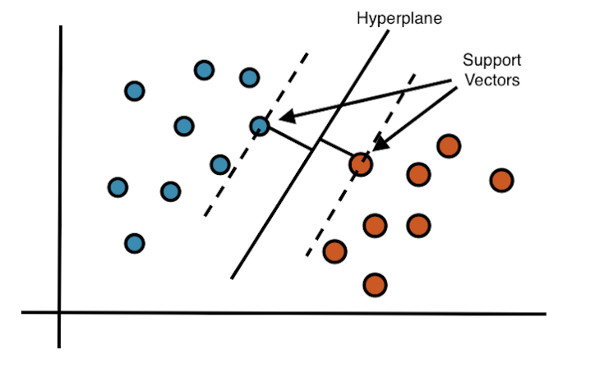
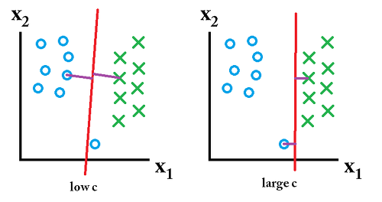
SVM
Support Vector Machine
Find hyperplanes in the possible space for linear classification
for maximizing the distance from the hyperplane to the data points
Implement the structural risk minimization (SRM)
principle that is known to have high generalization performance

Slide 6
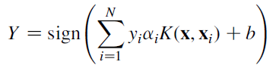
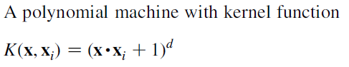
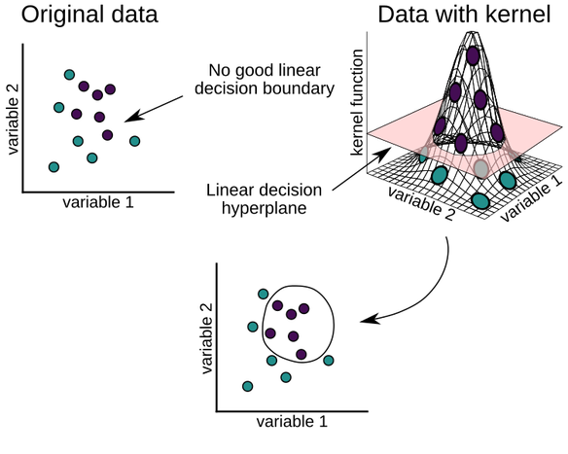
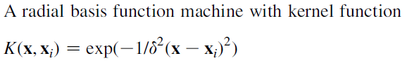
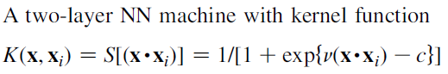
SVM
Support Vector Machine
Non-separable cases
Impossible to linear classification
Using 'Kernel function'

Slide 7
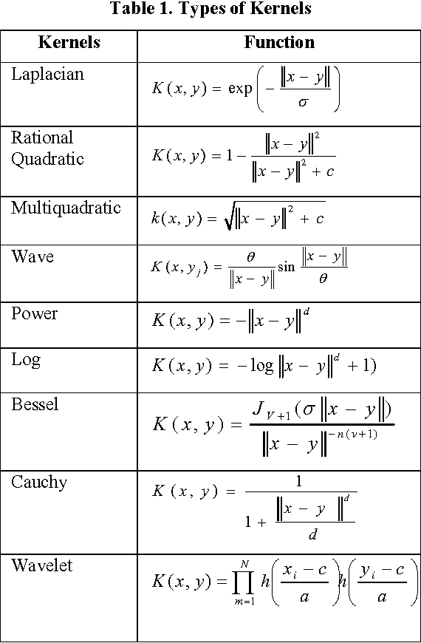
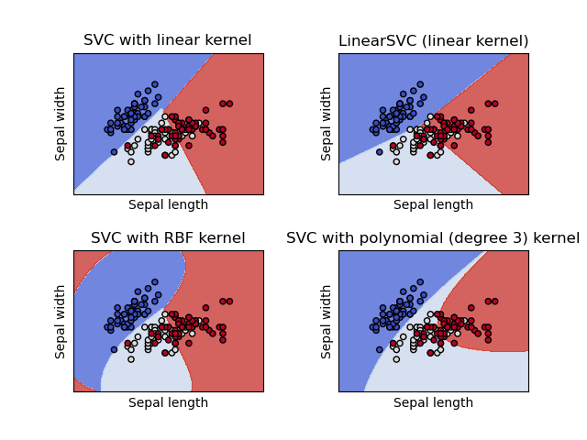
SVM
Support Vector Machine
Important things
Kernel function and function parameter
Upper bound (or Cost)
Indicates how far outliers are allowed

Slide 8
Test setting
SVM
Using MATLAB SVM toolbox with RBF kernel
Change upper bound C and kernel's parameter 'bandwidth'
each range are between 1 to 100
BPN
Three-layer neural network
with the same number of input nodes in the hidden layer
the hidden and output nodes use the sigmoid function.
The NN algorithms software NeuroShell 2 version 4.0 (neverminds...)

Slide 9
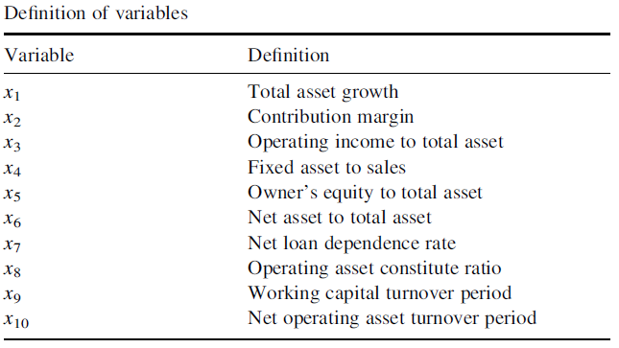
Test setting
Input variable selection
First stage
select 52 variables from more than 250 financial ratio by t-test
Second stage
select 10 variables using MDA stepwise method

Slide 10
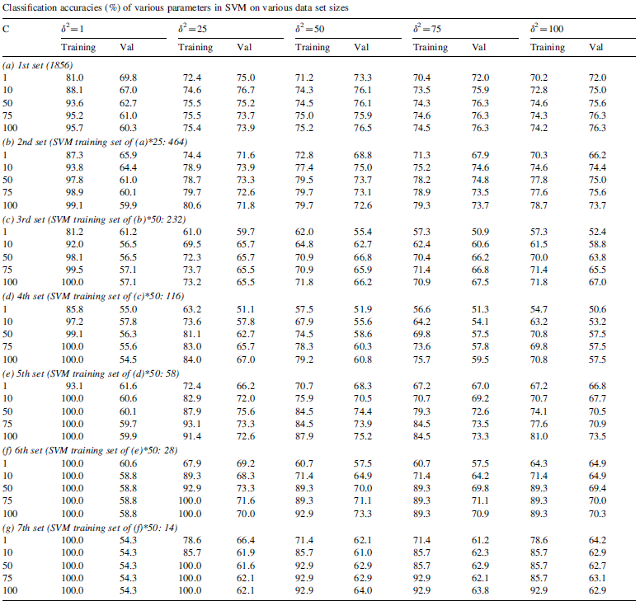
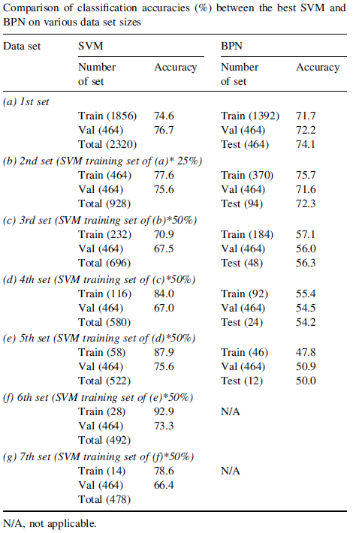
Results

Slide 11
Results
SVM analysis
Prediction performance is sensitive to kernel parameter and upper bound
Appropriate value for upper bound is important to generalization
large upper bound - overfitting
small upper bound - underfitting
Bandwidth of RBF kernel
large bandwidth - underfitting
small bandwidth - overfitting
prediction performance of the validation set is more stable and insensitive than that of training set

Slide 12
END

